Slide 1
Development of Web-Based E-Learning System
Oyemade Oluwayimika Rufus (080958)
Abayomi Damilola Rukayat (082177)

Slide 2
AIM AND OBJECTIVES
Aim
The project aims to use the internet as a medium of teaching and learning which could be accessible via laptops, tablets and smartphones.
Objectives
  The objectives of this project are:
  To automate academic learning process using web application.
  To use the concept of E-learning to ensure education is available to people that do not have access to physical educational facilities.

Slide 3
RELATED WORKS
Hybrid Web Teaching System(hyweb ) which uses Web and CD
Moodle: an open source Course Management System (CMS)
WebCT( Web Course Tools): The first successful Commercialware E-learning system
BlackBoard: founded in 1997 as the leading provider of e-education enterprise software applications and services

Slide 4
AVAILABLE TECHNOLOGIES
Web Server Technology:
This is the technology behind World Wide Web. It listens for request from the client such as browser like Netscape or Microsoft’s internet Explorer, processes that request and returns some data. This data usually takes a form of a formatted page with text and graphics. The browser then renders this data to the best of its ability and presents it to the user.
Examples: Microsoft Internet Information Server (IIS), Microsoft Personal Web Server (PWS), Apache HTTP Server

Slide 5
AVAILABLE TECHNOLOGIES
Database Technology
Database is a fancy word describing an organizational model for storing data. Almost every application requires the storage and manipulation of some form of data. A database provides a mechanism for organizing this data so that it is easily accessed and stored.
Examples: Microsoft MySQL Server(MSSQL), MySQL

Slide 6
AVAILABLE TECHNOLOGIES
Scripts Technology
This consist of the languages normally used to dynamically generate HTML which could be on the server-side or on the client-side, building parts of the web page as the browser loads the document.
Examples: Hypertext Preprocessor(PHP) which is server-side based, JavaScript which is client-side based.

Slide 7
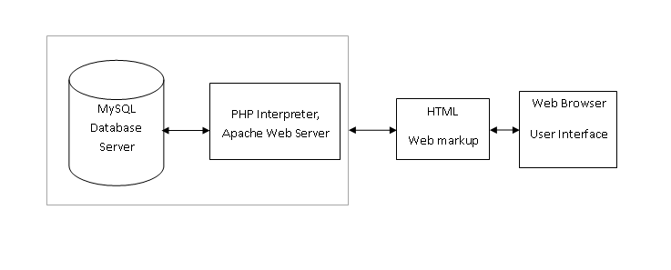
DESIGN
Server Architecture

Slide 8
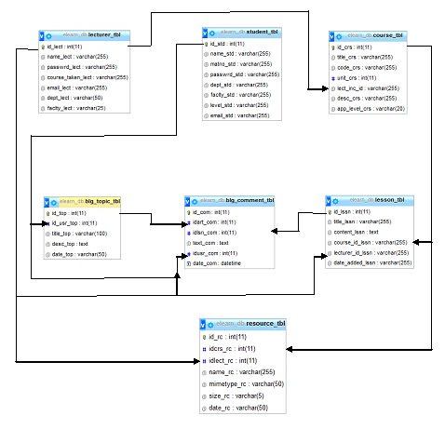
Database Entity Relationship Diagram

Slide 9
DESIGN AND IMPLEMENTATION
The e-learning platform called “VirtualClass!” is developed using PHP which is embedded in HTML codes. The platform is designed with much consideration on security issues to avoid unauthorised users to obtain documents or lecture notes or unauthorised persons login through the admin login section
The database was created by using PHPMyAdmin that is available with the installation of the WAMP package in EasyPHP. It’s a front end to executing SQL queries by clicking and writing queries if necessary

Slide 10
DESIGN AND IMPLEMENTATION
Content Authors:
The lecturers through their portal have the ability of adding new lessons and materials which is stored in the database or uploaded to the server as the case may be for the students to consumes
Content Users:
The students on logging in will be able to view lessons based on courses and their currently level. They can also download or view course materials anytime they want, anywhere

Slide 11
INTERFACES

Slide 12
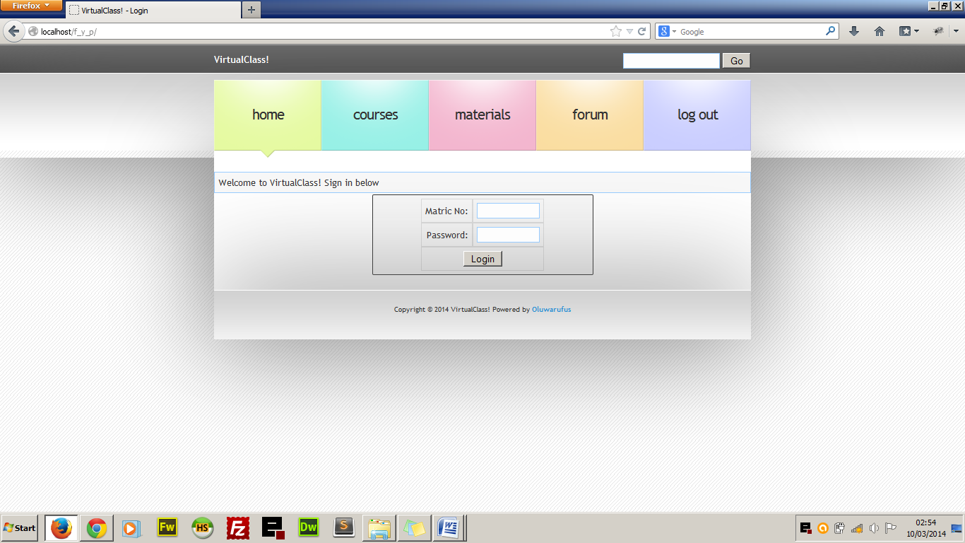
LOGIN PAGE
The student is required to enter his or Matric no that serves as the username and password. A login session is set before a user is granted access to the resources that are available.

Slide 13
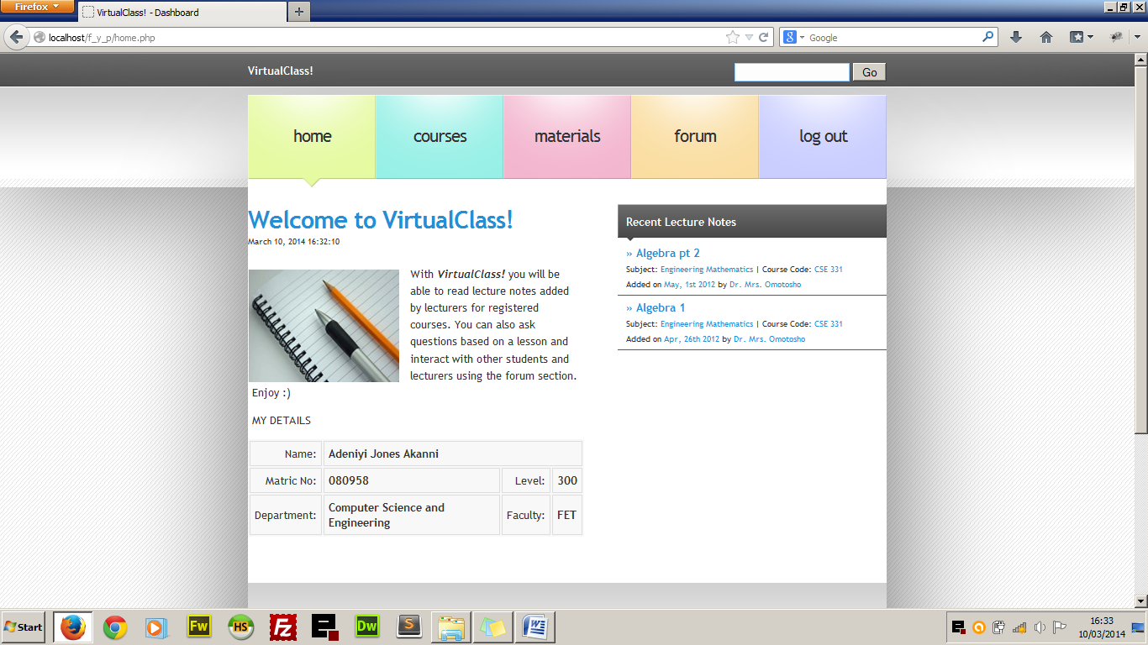
STUDENT HOMEPAGE
After a successful log in the user is redirected to the student’s homepage where resources can now be accessed because of the active log in. The homepage is characterised by a brief history of what the student can do with the web application.

Slide 14
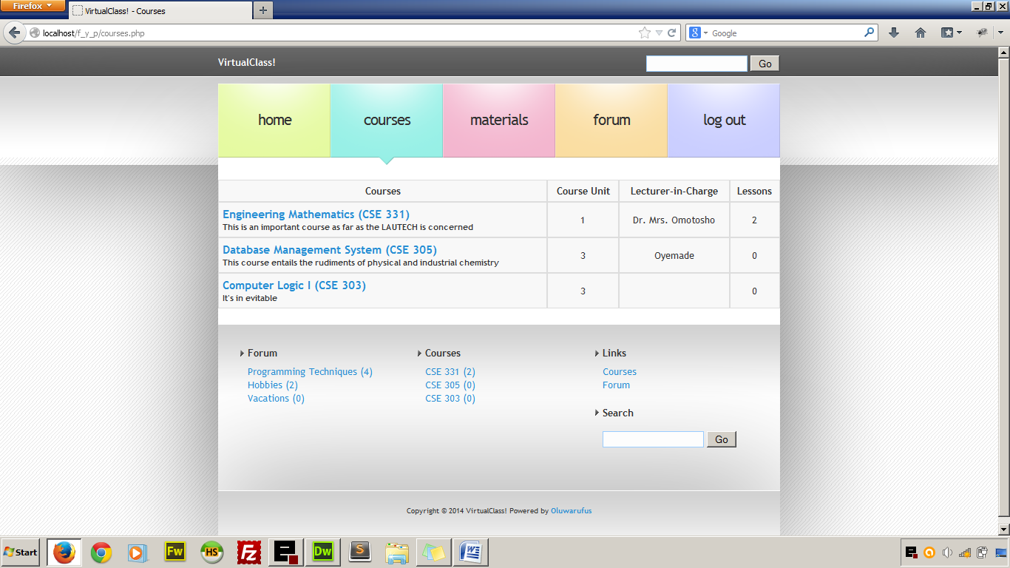
Student registered courses detail
When the student clicks on course from the main menu, he/she is redirected to the page that contains all the registered courses with a brief introduction to each course, course code and unit, the lecturer-in-charge and the number of lessons under each courses.

Slide 15
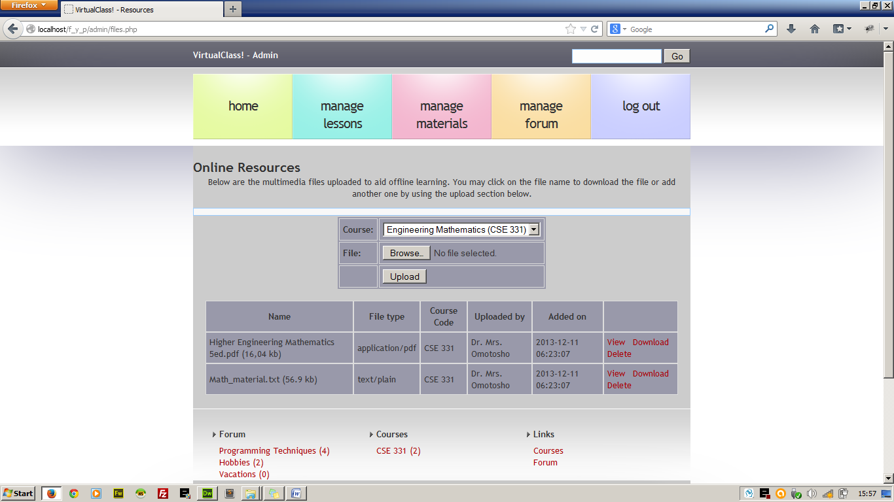
LECTURER Upload page
Lecturers using the web application will be able to upload files which could be normal documents or audio visual files that could help the student further in their studies. Lecturers are granted the privilege of adding and deleting as the case maybe. The uploaded material is bounded with the course that the lecturer is taking.

